Slide 1
Technical Presentation Team SpaceRacer
Audi Autonomous Driving Cup 2016

Slide 2
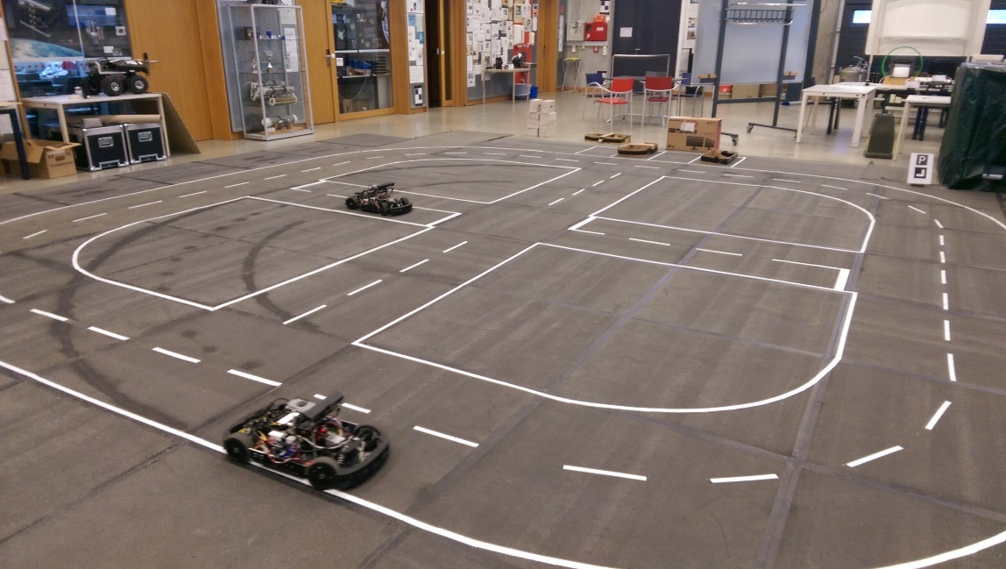
Agenda
Architecture
Vision System
Path Planner
Pose Controller
Parking
Demo

Slide 3
Architecture
Odometry
Pose
Jury Module
Maneuvers
Steering
Speed
Camera
RGB
Image Processing
Lanes
Path Planner
Poses
Controller
Crossings
Poses
RGB
Marker Detection
Road Signs
Maneuvers
Keyboard

Slide 4
Vision system
Asus Xtion
RGB Image
Preprocessing
Inverse Perspective Mapping
Feature Detection
Lane Data
Crossings
Filtering
Parking spots

Slide 5
Image Processing Filter
Calculate IPM and Top Down -> World transforms
From camera angle and position
From odometry
Manage worker threads
Spawn and destroy
Distribute work
Manage preferences and pin connections
Forward preferences to workers
Communicate with other filters

Slide 6
Worker Threads
Thread 1 | Thread 2
Processing Frame 1 | Idle
 | Processing Frame 2
Idle
Processing Frame 3
 | Idle
 | Process Frame 4
Configurable number of workers
Staggered execution
Perform IPM
Perform Filtering
Threshold, Dilation
Perform Feature Detection
Lanes
Crossings
Beginning of parking spaces

Slide 7
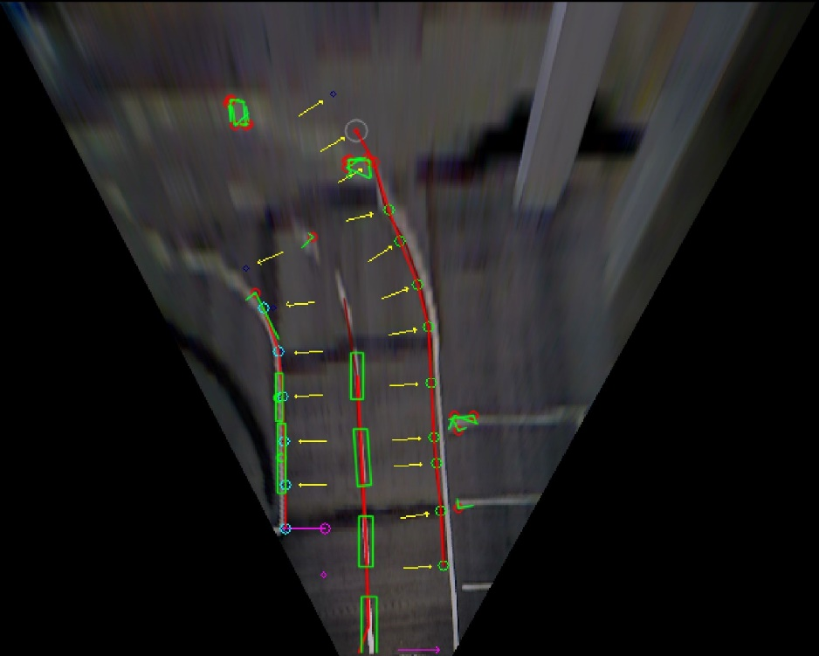
Lane Detection
Data fusion:
Previous lane data
Detected points in filtered image
Extrapolation from found points
Transformed to world coordinates
Center lane:
Contour detection
Known shape, tracked across frames
Filtered using previous data
Matched to expected line
Transformed to world coordinates

Slide 8
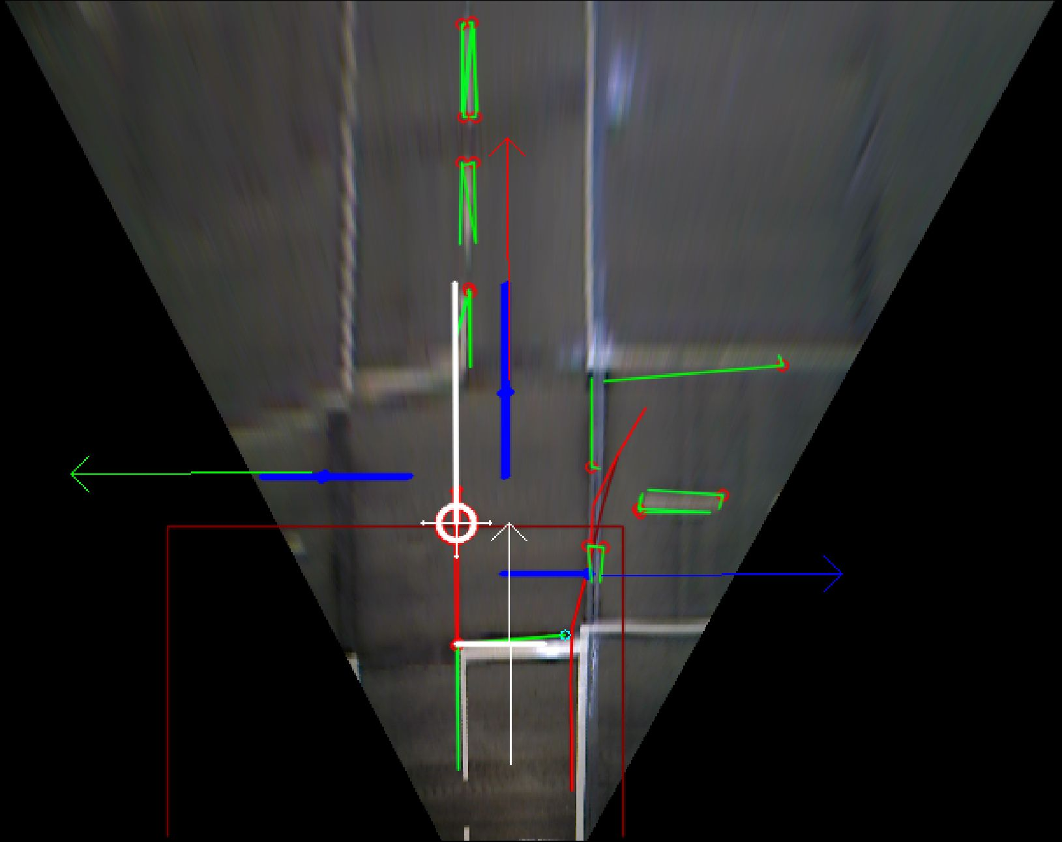
Crossing Detection
Detect corners
Find center point
Find available exits
Calculate goal poses
Find right angles in contour hulls
Check side lengths
Distance known from specs
Angle known from corner sides
Check for free space ahead and to left and right
Relative to center point
Offsets known
Filter out false positives
Check position relative to lanes
Transformed to world coordinates

Slide 9
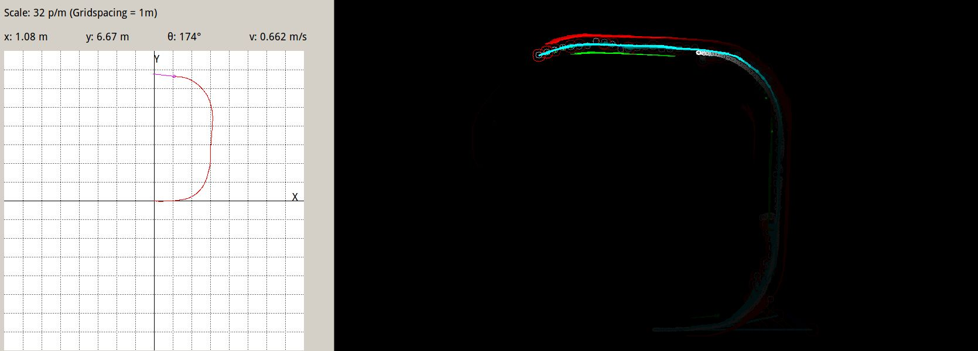
Path Planner

Slide 10
Path Planner Filter
Lane Data
State machine for maneuver execution
Controller Commands
Crossing Data
Odometry
Maneuvers
Triggers to activate/reset other filters
Lights
Data fusion
Road signs

Slide 11
Path Planner Filter
Generate driving path via data fusion
Weighted average between:
Previous driving path
Right, left and center lane data from worker threads
Extrapolated points
Merge crossing and road sign data
Average center points
Store detection counters
Path
Lanes
Pose

Slide 12

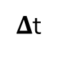
Pose Controller
Pose <x, y, $Θ$, speed>
Process Block Velocity
PI controller
Actual pose
Process Block Pose
PI controller
Velocity
Desired pose
Steering
$Δ$t

Slide 13
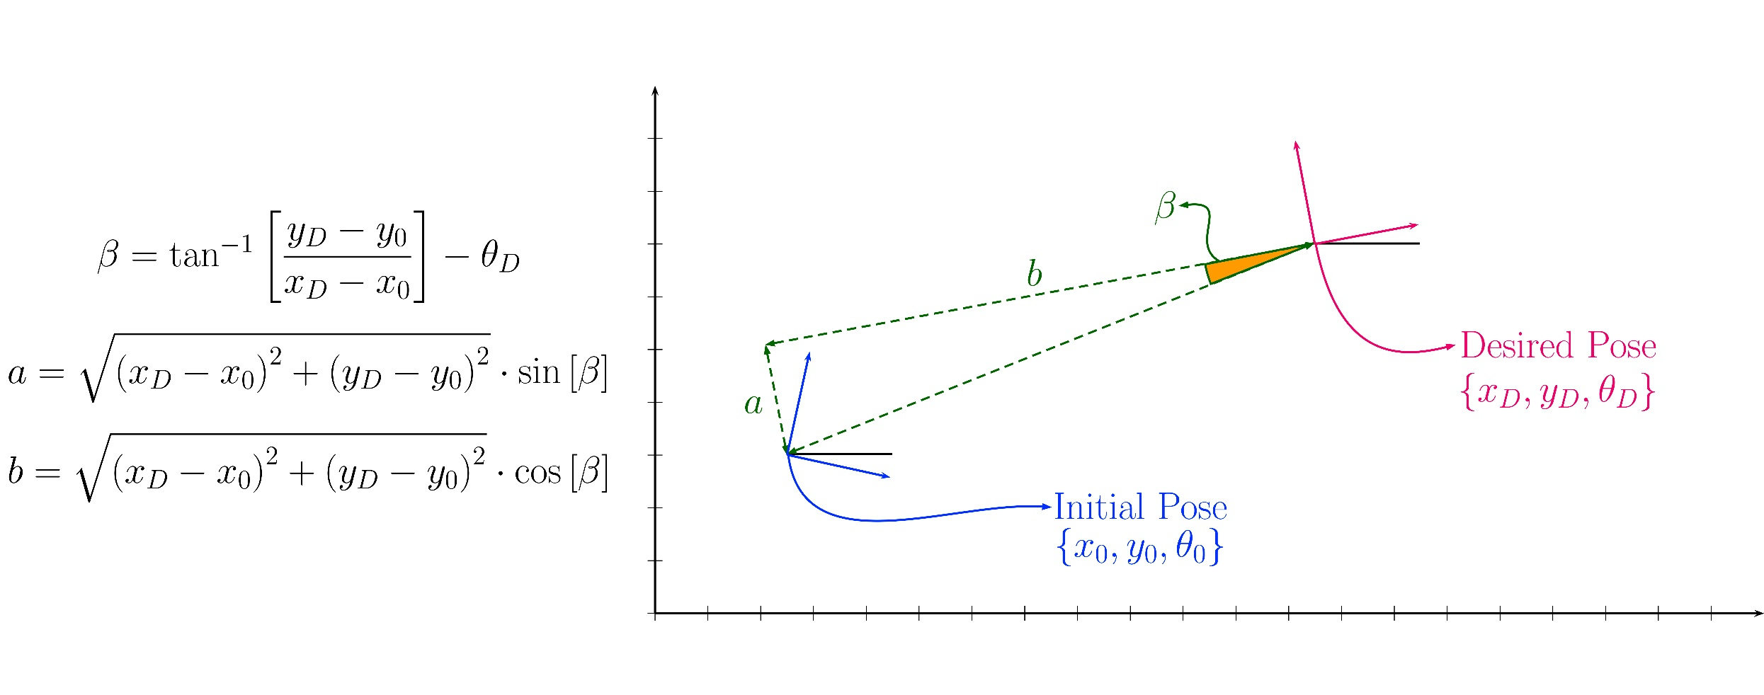


Slide 14
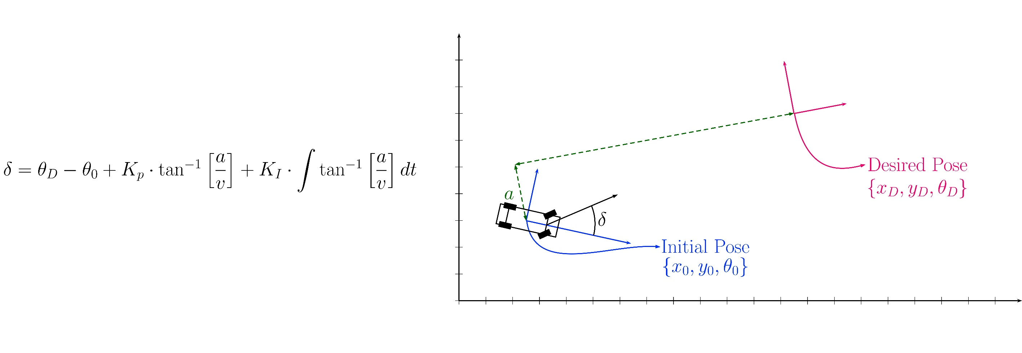

Slide 15
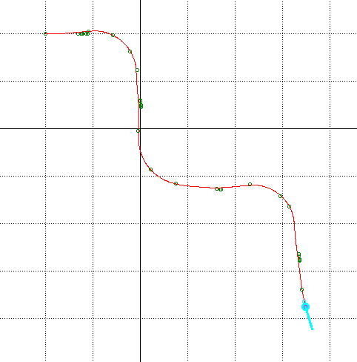
Pose Controller: Results
Steady state error on pose following:
-> Integrator on correction angle

Slide 16
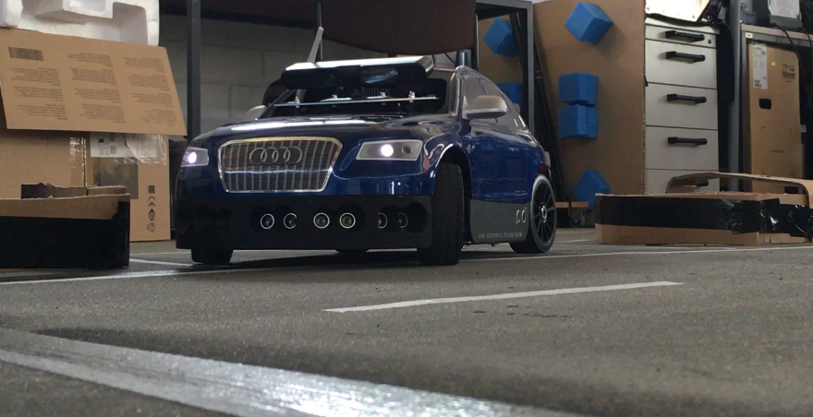
Parking

Slide 17
Parking Finder
Detect Parking Area sign
Search for start of parking slots
Approach start of parking slots
Search empty parking slot with ultrasonics
Execute composite maneuver

Slide 18
Parking Maneuver
2
Initial starting pose – reference pose
Reorient for entry at 15 degrees from reference
Change orientation to 45 while going backwards
Fix orientation and center car in parking space
1
Reference Pose
3
4

Slide 19
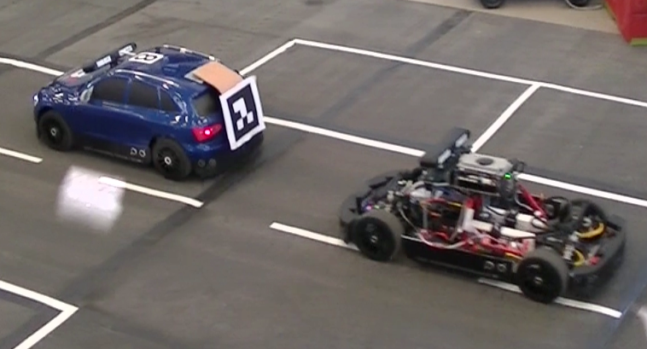
Demo

Slide 20

Formation Driving
Use cases
Traffic jams
Convoys
Implementation
Leader position extracted from marker
Follower tracks leader’s path using the pose controller

Slide 21
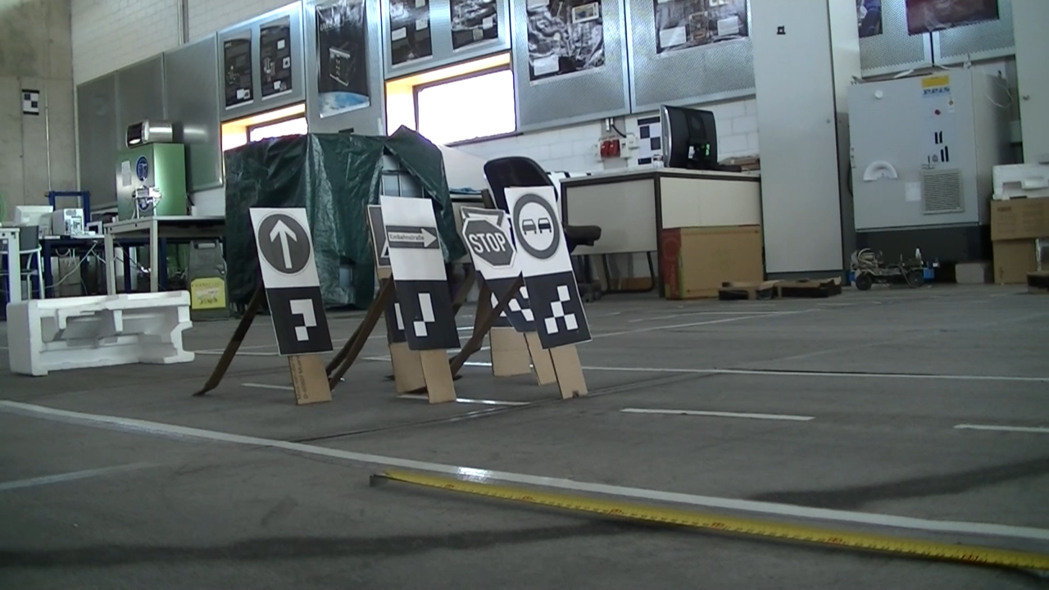
Thank you for your attention
Questions?

